Slide 1
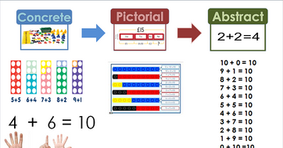
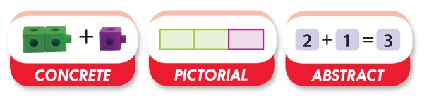
Maths – No Problem!
Parent Workshop

Slide 2
Aims of the session
Curriculum overview
Why Maths - No Problem
What Maths - No Problem is
Mastery approach to mathematics
Overview of Maths - No Problem
How you can help at home
A typical maths lesson at Holley Park

Slide 3
Aims of the National Curriculum
The national curriculum for mathematics aims to ensure that all pupils:
Become fluent in the fundamentals of mathematics, including through varied and frequent practice with increasingly complex problems over time, so that pupils develop conceptual understanding and the ability to recall and apply knowledge rapidly and accurately.
Reason mathematically by following a line of enquiry, conjecturing relationships and generalisations, and developing an argument, justification or proof using mathematical language.
Can solve problems by applying their mathematics to a variety of routine and non routine problems with increasing sophistication, including breaking down problems into a series of simpler steps and persevering in seeking solutions.

Slide 4
Curriculum coverage
FLUENCY – Being able to recall facts and solve calculations with speed. This also relates to solving simple word problems.
REASONING – Being able to explain the steps in a process, how an answer was found, or explaining mistakes or misconceptions in a process.
PROBLEM SOLVING – Children are able to solve complex problems that require recall of facts, reasoning, and logical thinking. Children are also required to think about representing questions in different ways to help solve a problem.

Slide 5
Why Maths - No Problem?
Children will have a greater conceptual understanding of number and calculation. They will be able to visualise and generalise more readily due to a more in-depth understanding.
All children will be fully supported through accessing concrete equipment and use of visual models to support understanding.
Rapid graspers will be challenged through exposure to unfamiliar problems, development of reasoning skills and by exploring multiple ways to manipulate numbers and solve problems.
All learners will access teaching of content which matches the expectations of the curriculum in England and be supported further, if needed. The resources match the expectations for formal written methods set out by the government, alongside greater understanding in order to reach ‘mastery’.

Slide 6
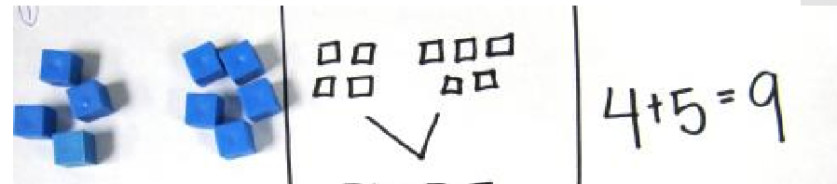
CPA approach
Concrete, pictorial, abstract (CPA) is a highly effective approach to teaching that develops a deep and sustainable understanding of maths.
doing seeing abstract

Slide 7
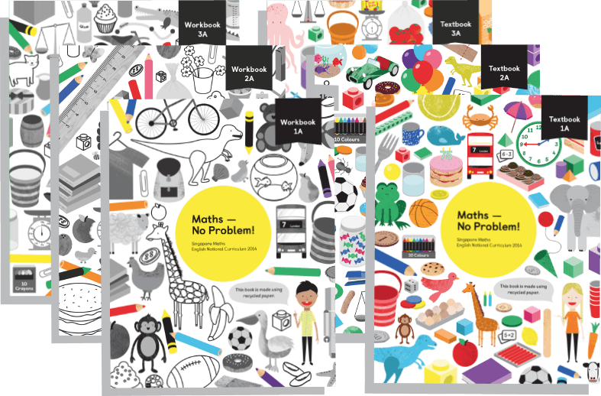
What is Maths – No Problem?
Maths — No Problem! is a series of textbooks and workbooks written to meet the requirements of the National Curriculum.
The MNP Primary Series was assessed by the DfE’s expert panel, which judged that it met the core criteria for a high-quality textbook to support teaching for mastery.
As a result, the MNP Primary Series are recommended textbooks for schools on the mastery programme.

Slide 8
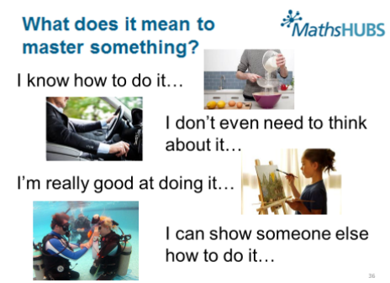
What is mastery?

Slide 9
Mastery of Mathematics
Achievable for all
Deep and sustainable learning
The ability to build on something that has already been sufficiently mastered
The ability to reason about a concept and make connections
Conceptual and procedural fluency
Involves a longer time spent on key topics, providing time to go deeper and embed learning.
Procedure has to be backed up by understanding

Slide 10
Mastery
Involves a development or three forms of knowledge:
Factual – I know that
Procedural – I know how
Conceptual – I know why

Slide 11
Structure of Maths – No Problem!
Concepts merge from one chapter to the next e.g.
Chapter 1 – Place Value
Chapter 2 – Addition and Subtraction
Each chapter has a series of lessons to follow
Children master topics before moving on

Slide 12
How lessons are taught
The parts to the lesson are:
Anchor/explore task –entire class work on problem to solve, use of talk partners and teacher/ TA guiding. The children are encouraged during this time to think of as many ways as possible to solve the problem and explain their ideas.
Let’s Learn – look at methods together. Explain the method to your partner. What can we learn from this method?
Guided practice – practice new ideas with talk partners. Teachers/TAs assess understanding and support where needed.
Independent practice – mostly independent, teacher/teaching assistant work with guided groups or specific children identified from guided practice. Once children have mastered the concept they use their reasoning and problem solving skills to develop their depth of learning.

Slide 13
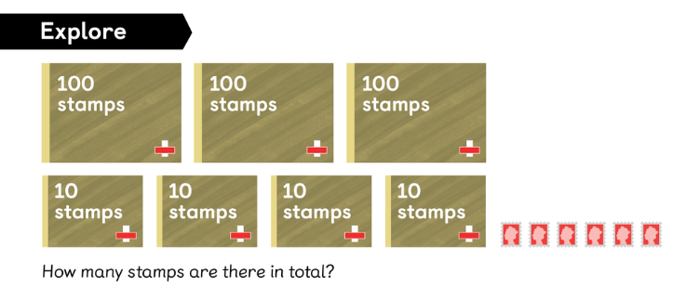
Explore task

Slide 14
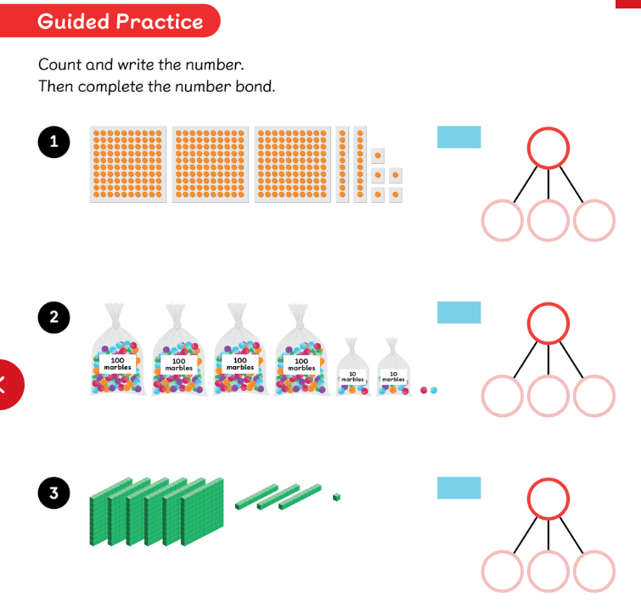
Guided practice

Slide 15
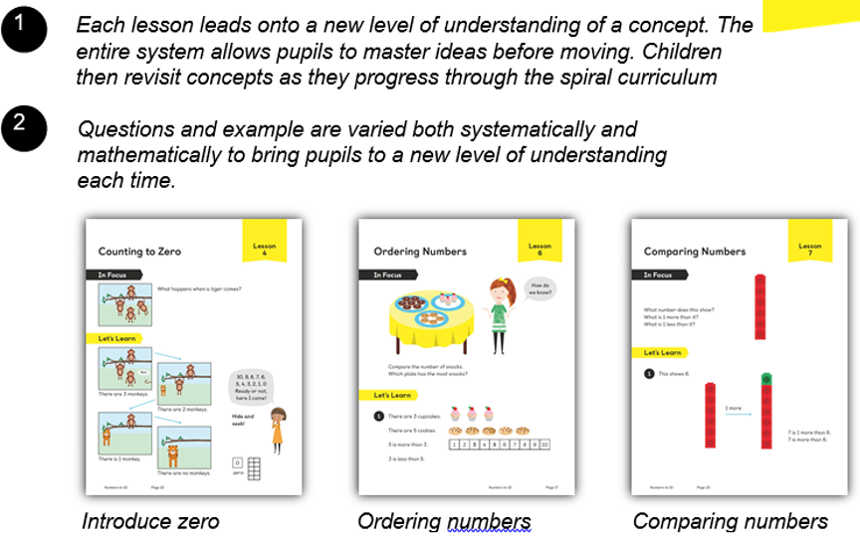

Slide 16
Workbooks
Allow children to show their understanding of a concept by solving problems displayed in different ways
The questions are set up to ensure children understand the concept forwards, backwards and inside out
For rapid graspers this consolidates any previous learning before they move onto greater depth challenges
Children can work at their own pace through the questions

Slide 17
Maths journals
Show different methods of working out
Guided practice
Challenges

Slide 18
How will children be challenged?
Make links between previous learning
Think about problems in different ways
Have opportunities to explain their reasoning
Find and explain generalisations
Use rich mathematical language when explaining ideas
Solve complex problems which expand on their mathematical knowledge
Work with a range of manipulatives to consolidate their understanding
Work with a mix of children in groups, pairs and independently

Slide 19
Challenge
Problem solving/ reasoning challenges
Explain using drawing/ equipment
Explain orally/ through writing
Write their own problem
Invent a method/ game
Create their own question
Make connections
Identify rules/ generalisations
Correct a mistake
Odd one out
Find something new

Slide 20
How are children supported?
Make links between previous learning
Think about the way they know to solve problems
Have opportunities to listen to mathematical vocabulary from peers and use themselves
Be given more time to work on tricky concepts
Work with a range of manipulatives to solve problems practically
Work with a range of children in groups, pairs and independently
Scaffold learning- extra clues and support

Slide 21
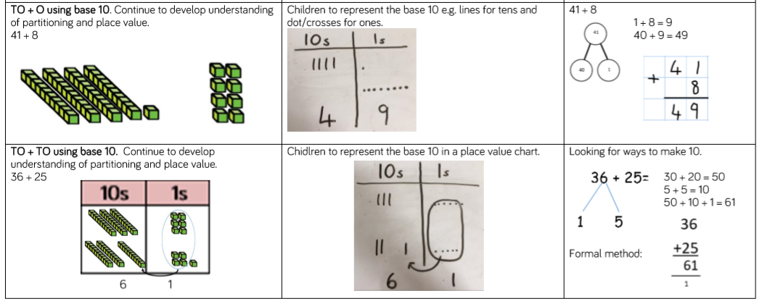
Column addition with regrouping

Slide 22
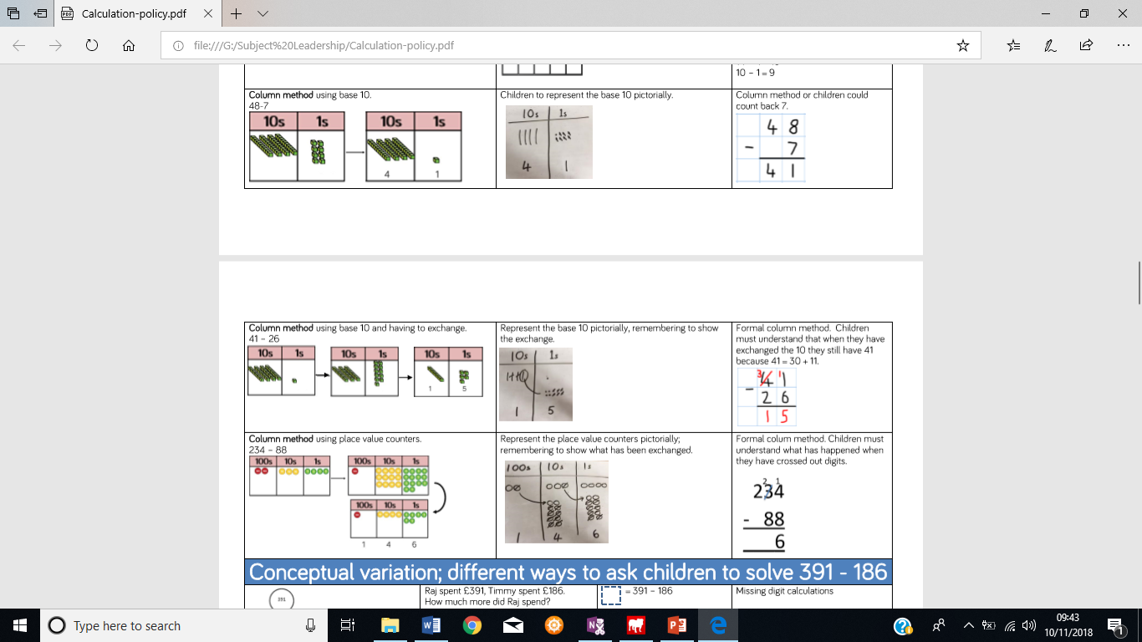
Column subtraction with regrouping

Slide 23
Year 4 MTC
Year 4 complete MTC in June.
MTC tests children’s times table knowledge. Children are given 25 questions and 6 seconds to complete each question.
Children will still complete other assessments however this is for teachers to recognise any missed areas of learning.

Slide 24
How can I help at home?
Continue to complete homework with your child.
Give ‘Real-life’ maths examples when opportunities arise.
Play maths games.
Allow children time to complete Times Tables Rock Stars.
Ask your child multiplication questions!

