Slide 1


Welcome
Mrs Whyte (Y1) and Mrs Kelters (Y2)

Slide 2



Slide 3
Our school Day
8 – 8.30am | Breakfast Club (via main entrance)
8.30 – 8.45am | School Gates open
8.50am | Morning registration
10.30 – 10.45am | Morning Break
12 – 12.55pm | Lunch
3.15pm | Dismissal
Mon – Thu 3.15 – 4.30pm 4.30 – 5.30pm Friday 3.15 – 4.15pm | Afterschool Club Wrap-around Care Afterschool Club
Please be aware that Breakfast Club, Afterschool Club and Wrap-around Care must be booked in advance via the School Comms App.

Slide 4
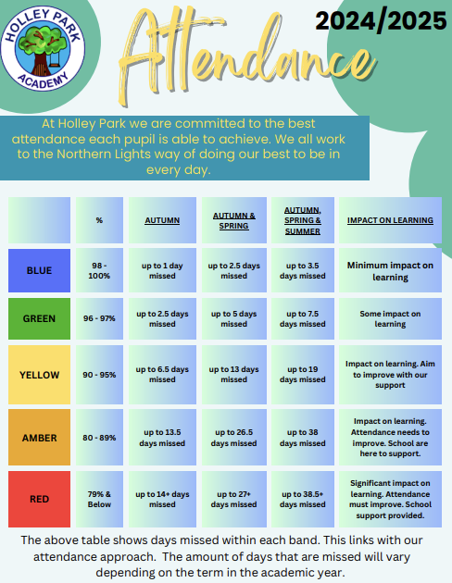
Attendance
At Holley Park Academy, we strongly believe that every school day counts, and therefore it is of the upmost importance that children attend school regularly to help support their academic, social and personal growth.
We are here to support families however we can to achieve the best possible attendance for every child. As part of this support structure, you will be regularly updated on your child’s attendance as part of half termly letters and parent evening sessions.
In line with our attendance policy, Mr Garrett, our Attendance Champion, may also contact you on an individual basis if children have reached specific stages of absence (5 days, 10 days, 15 days and 19 days+)
Our full attendance policy can be viewed on our school website.

Slide 5
Reading Y1
Year 1 will continue to follow Little Wandle scheme for phonics.
Currently reviewing phase 4 before moving onto phase 5 (which will last most of the year).
Summer Term – Year 1 phonics screen.
Children will continue with group reading and reading book they have had that week in class will come home at the end of the week.
Parents are encouraged to listen to the children read and comment in their reading diary.
Books to be returned on a Monday.
Children are encouraged to read for pleasure and children can bring home a book of their choice (this is to be shared with a sibling or adult) and returned each week.

Slide 6
Reading Y2
Year 2 will continue to follow Little Wandle scheme for phonics.
Currently reviewing phase 5 before moving onto Little Wandle spelling scheme.
Children will continue with group reading and reading book they have had that week in class will come home at the end of the week.
Parents are encouraged to listen to the children read and comment in their reading diary.
Books to be returned on a Monday.
Once children have completed Phase 5 reading they will move onto Little Wandle fluency in books. These are chapter books and remain in school therefore children will instead take home a levelled reading book from our accelerated reader scheme in preparation for Key Stage 2.

Slide 7
Maths
Children will continue to follow Maths No Problem scheme which is a mastery approach to mathematics.
Children use a range of resources and methods to support their understanding of each mathematical concept.
Children work with a partner to share their thoughts and working out.
Children have a mix of journal work and textbook work.
Number is the main focus throughout the Autumn term.

Slide 8
Uniform
Children are expected to be in full school uniform (royal blue jumper/ cardigan - does not have to be branded, white shirt, school tie, grey/ black trousers, skirt or shorts, summer dresses in the Summer term)
There is free pre-loved uniform at the school office for parents to access.
Children must not wear jewellery (this includes earrings) to school other than a watch (no watches with internet access or camera).
Please can all items of school uniform be labelled with child’s name.
Children should bring a coat to school everyday.
Children also need to bring a water bottle and a bag to school each day.

Slide 9
PE
PE kits can be worn on a PE day, these are - plain black/ navy sweatshirt or hoody (no logo), team colour t-shirt (no football tops), navy blue or black shorts, leggings or jogging bottoms and appropriate PE shoes.
PE day for Year 1 and Year 2 is a Thursday.

Slide 10
Homework
Children will get alternative maths and english homework each week to complete, this will be linked to their class work.
Homework will go home at the end of the week and should be returned by the following Wednesday.
Year 2 will also receive spellings to learn for a spelling test on a Friday. Spellings are linked to the weekly phonics.

Slide 11
Home – school Partnerships
At Holley Park Academy, we know that a strong, positive partnership between home and school is vital for children to flourish. We have worked extremely hard last academic year to develop home-school partnerships and strengthen the way we communicate with our families.
We aim to keep parents and carers fully up-to-date of what is happening in school via several channels of communication:
Class Dojo
School Comms (text) system
Email
School website (www.holleyparkacademy.co.uk)
School Facebook page
Whole-school letters and termly newsletter (sent electronically)
As always, your child’s class teacher should be the first port of call for any day-to-day queries or low-level concerns.
Should you wish the contact the school leadership or administrative team, please do so via contacting the main school office via 0191 417 0303 or info.holleypark@nllt.co.uk

