Slide 1


Welcome
Mrs Gallant and Ms Mackay

Slide 2



Slide 3
Our school Day
8 – 8.30am | Breakfast Club (via main entrance)
8.30 – 8.45am | School Gates open
8.50am | Morning registration
10.30 – 10.45am | Morning Break
12 – 12.55pM | Lunch
3.15pm | Dismissal
Mon – Thu 3.15 – 4.30pm 4.30 – 5.30pm Friday 3.15 – 4.15pm | Afterschool Club Wrap-around Care Afterschool Club
Please be aware that Breakfast Club, Afterschool Club and Wrap-around Care must be booked in advance via the School Comms App.

Slide 4
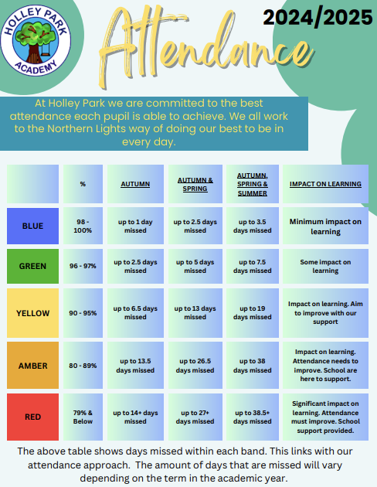
Attendance
At Holley Park Academy, we strongly believe that every school day counts, and therefore it is of the upmost importance that children attend school regularly to help support their academic, social and personal growth.
We are here to support families however we can to achieve the best possible attendance for every child. As part of this support structure, you will be regularly updated on your child’s attendance as part of half termly letters and parent evening sessions.
In line with our attendance policy, Mr Garrett, our Attendance Champion, may also contact you on an individual basis if children have reached specific stages of absence (5 days, 10 days, 15 days and 19 days+)
Our full attendance policy can be viewed on our school website.

Slide 5




Reading
Reading Records
Accelerated Reader

Slide 6

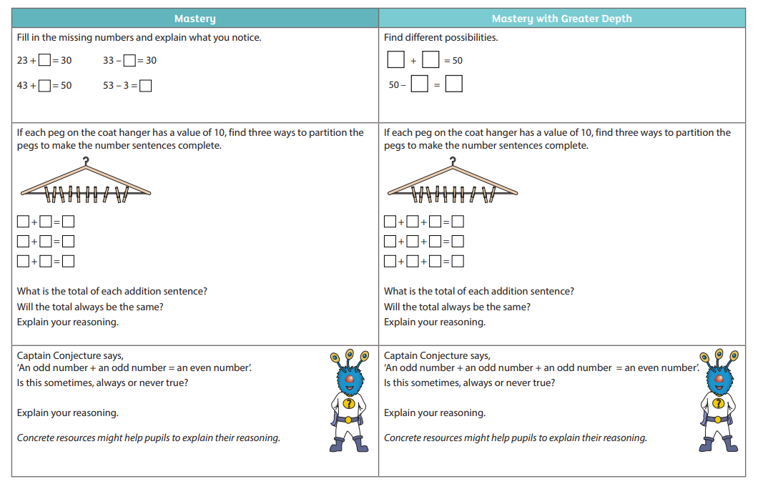
Maths
Maths No Problem
The mastery approach
Overview of the structure of the lessons

Slide 7
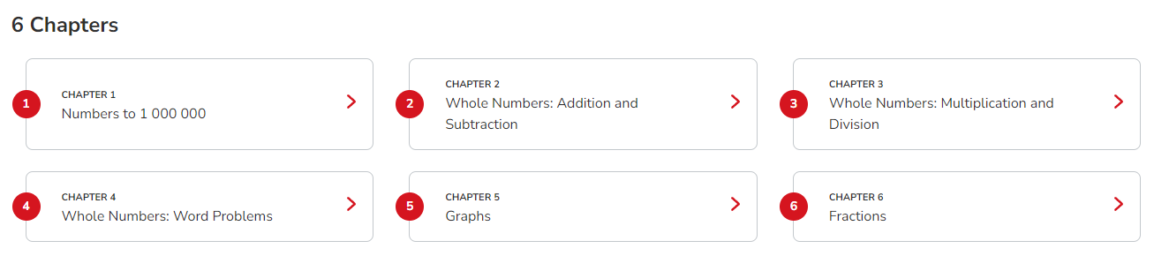
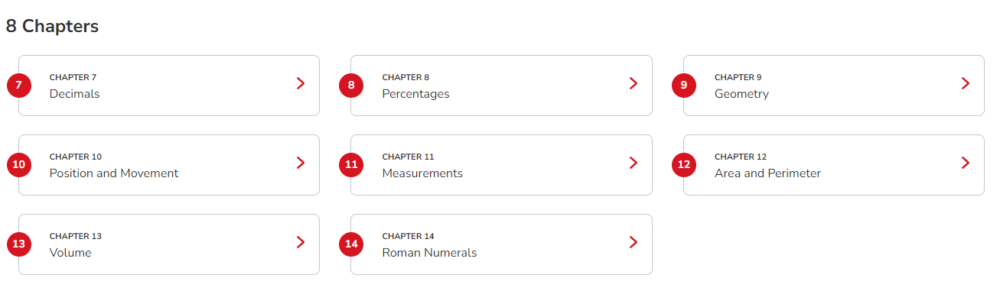
Maths – Year 5

Slide 8
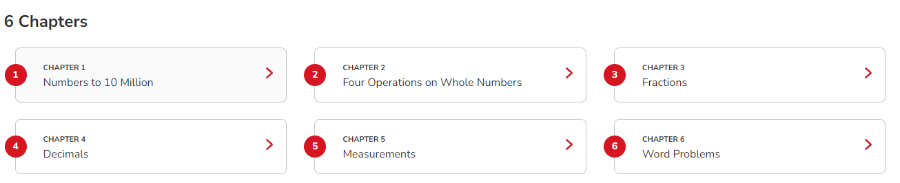
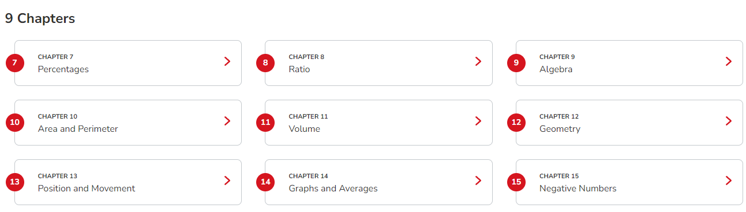
Maths – Year 6

Slide 9
Uniform and PE kits
Please can all children wear the appropriate school uniform .
royal blue jumper/ cardigan - does not have to be branded,
white shirt, school tie
grey/ black trousers, skirt or shorts)
Parents can access free pre-loved uniform anytime in the foyer of school.
Children must not wear jewellery to school other than a watch (no watches with internet access)
P.E. kits – include plain black/ navy hoody and no football tops

Slide 10
Homework
Every Friday children will get either Maths or English homework in CGP book.
To be completed and returned the following Wednesday.
Weekly spellings given out on Friday - following year specific scheme.
Friday – spelling test

Slide 11
Home – school Partnerships
At Holley Park Academy, we know that a strong, positive partnership between home and school is vital for children to flourish. We have worked extremely hard last academic year to develop home-school partnerships and strengthen the way we communicate with our families.
We aim to keep parents and carers fully up-to-date of what is happening in school via several channels of communication:
Class Dojo
School Comms (text) system
Email
School website (www.holleyparkacademy.co.uk)
School Facebook page
Whole-school letters and termly newsletter (sent electronically)
As always, your child’s class teacher should be the first port of call for any day-to-day queries or low-level concerns.
Should you wish the contact the school leadership or administrative team, please do so via contacting the main school office via 0191 417 0303 or info.holleypark@nllt.co.uk

